Slide 1
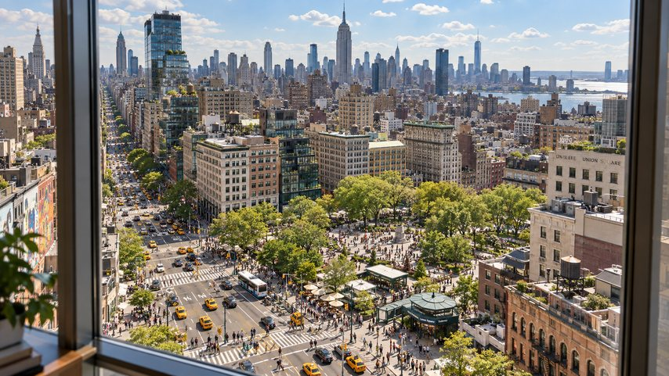
A City Holiday
One release on one page: the video, the track, and the cover.

Slide 2
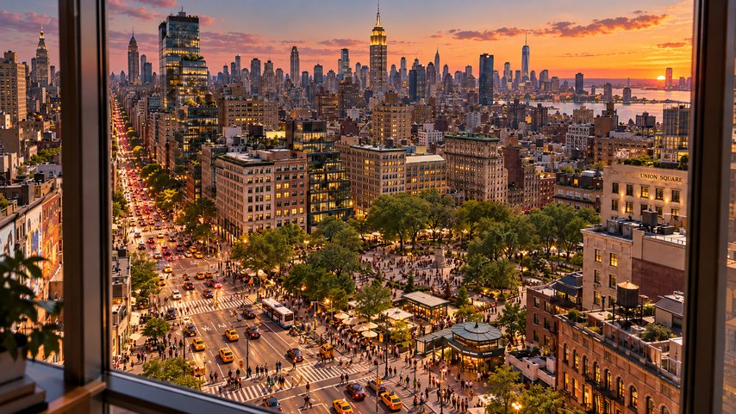
From noon to night
The same window, three times a day. The images are opened from file codes.

Slide 3
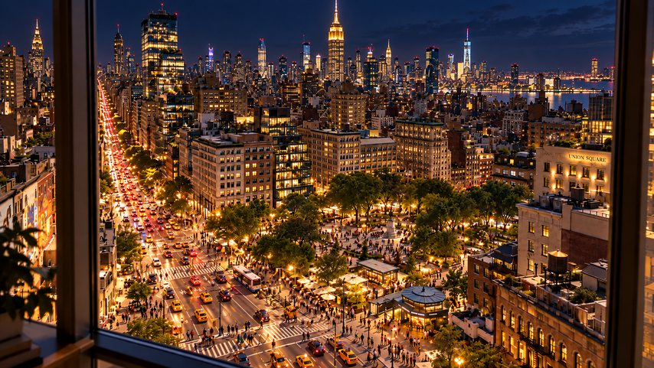
Open, drag, keep reading
Every file on the page stays open while visitors scroll.

